Slide 1
Australian Early-Mid Career Researcher Forum
The voice of Australia’s future scientific leaders
The Forum engages with early-mid career scientists from around Australia and advises the Academy on the key issues raised by young researchers, to help inform its policy recommendations to government.
The Forum is the national voice of Australia's young scientists. In response to the Strategic Review of Health and Medical Research, the Forum developed 23 recommendations that could provide realistic solutions to career structure, job security, funding, education, training and gender equity.
The Forum liaises with other national organisations, such as the Science & Technology Australia, Australian Society for Medical Research and the NHMRC Reference Group, to positively contribute to both Australia's health and economy, and the future careers of our emerging experts in this sector.

Slide 2

Identify the Issues
Discuss possible Solutions
Develop an Action Plan

Slide 3
Top two imperatives for young science researchers:
1. Career structure
2. Funding

Slide 4
The “pyramid” actually has a very different shape
?
Retirement Age
Prof
(E)
Prof A/Prof (D)
A/Prof
SRF
(C)
RF
Postdoc
(B)
~1500 in higher education institutions
Postdoc
(A)
PhD Students – ~4000 per year










Education (higher/other; private/govt)
Private
Health
Govt
?
Salaries on par
Research MSc/PhD graduates
Males paid more

Slide 5
There is a dearth of funds for the mid-career scientist
NHMRC Fellowships Scheme
(average age 41.6 years in 2011)
– approx. percentage allocation of total budget to levels
~12%
SRF A&B, PRF, SPRF
5 yr stipends, renewable (106 in 2012)
2002: 100% “excellent” were funded
2010: 0% NONE of the 47 “excellent” were funded
Overall success rate 2012: 46.2%
~3%
Career Development Fellowships I&II
(2-12 y post-PhD)
4 yr stipends (74 in 2011; 62 in 2012)
2011: 20% awarded to A/Prof.
2011: 1/3 to established Group Leaders
Overall success rate 2012: 18%
Early Career Fellowships
(0-2 y post-PhD)
4 yr stipends (120 in 2011; 128 in 2012)
Overall success rate 2012: 27.6%
~5%
Feel the squeeze?

Slide 6
NHMRC Project Grants: Mainly senior investigators are CIA and receive over half of the funding
Project Grants CIA (average age 50.5 yrs; 690x)
In 2011:
0.4% Emeritus Prof.
41.9% Prof.
21% Assoc. Prof.
36.4% Dr [26.6% + 9.8% (sole CI - NI)]
0.1% Ms
677 funded in 2012
20.7% Success rate
63.3%
New Investigator (75x)
8.1% Prof.
6.8% Assoc. Prof.
85% Dr
0.1% Ms
54 funded in 2012
17.9% Success rate
2011: Almost twice as many men (60%) as women (38%) listed as CIA on active NHMRC research grants

Slide 7
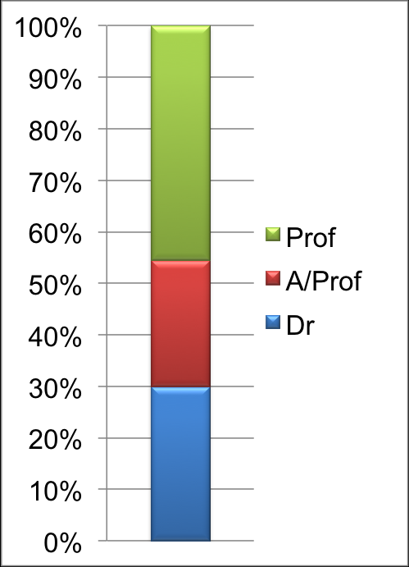

Slide 9
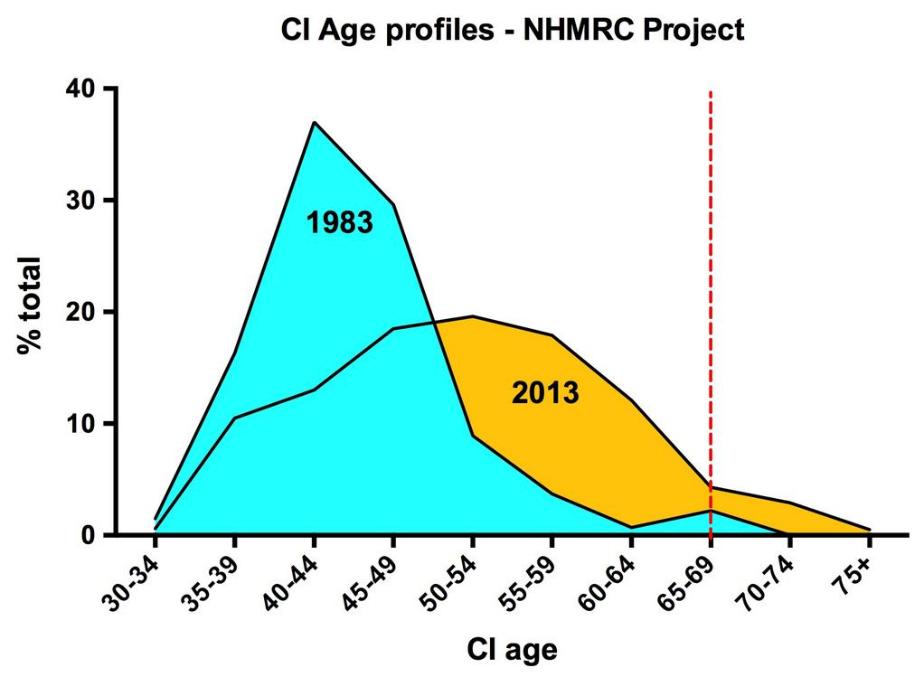

Slide 11
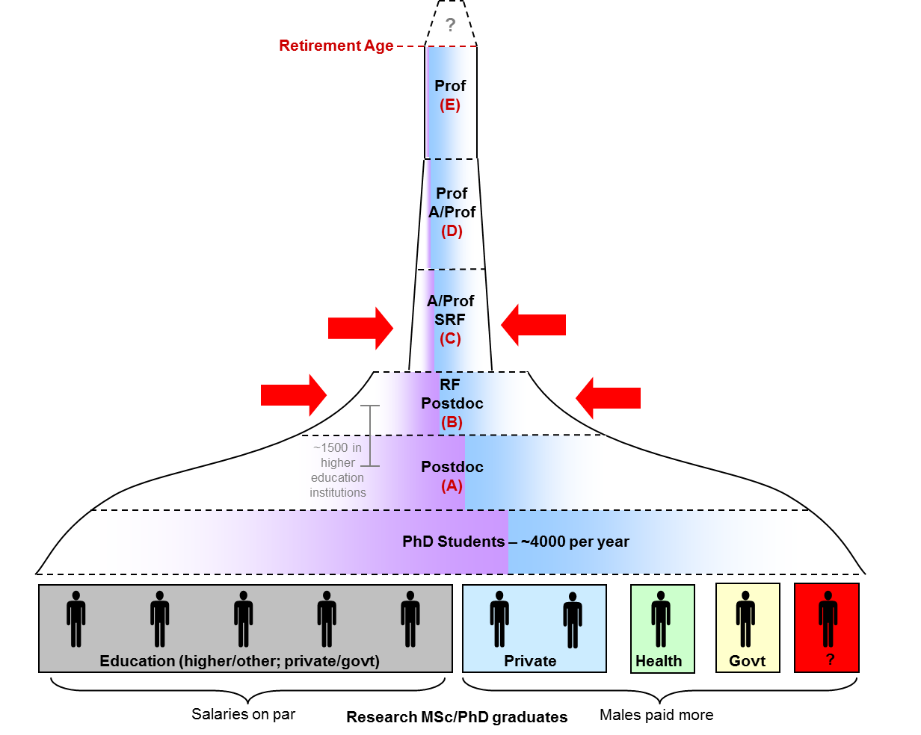
Workforce breakdown
GENERATE A REPORT
%
Percent funded/at what level
%
Age/gender breakdown
Individual
Institute
National

